Slide 1
No More GPU Cold Starts: Making Serverless ML Inference Truly Real-Time
Notes:
So let’s talk about serverless GPUs, where the cold start latency comes from, why it happens,
and what practical strategies significantly reduce or eliminate it.

Slide 2
The Promise of Serverless ML
The Dream
The Reality
Scale to zero when idle
Pay only for actual usage
No infrastructure management
GPU cold starts destroy everything
15-25 second startup times make real-time inference impossible
Notes:
The ideal picture of serverless is simple: zero infrastructure management, scale up on demand, and scale to zero when idle so there’s no cost when unused.
The issue is that GPU workloads do not start instantly.
Cold starts on GPUs commonly take 15 to 25 seconds, sometimes longer, which makes real-time inference impractical. By the time the GPU is ready, the user request that triggered it may have long since timed out.
The end result is that teams often avoid scale-to-zero and run “warm” GPUs continuously, which eliminates the cost advantage.
The key question becomes: why is the GPU cold start so slow, and what can we do about it?

Slide 3
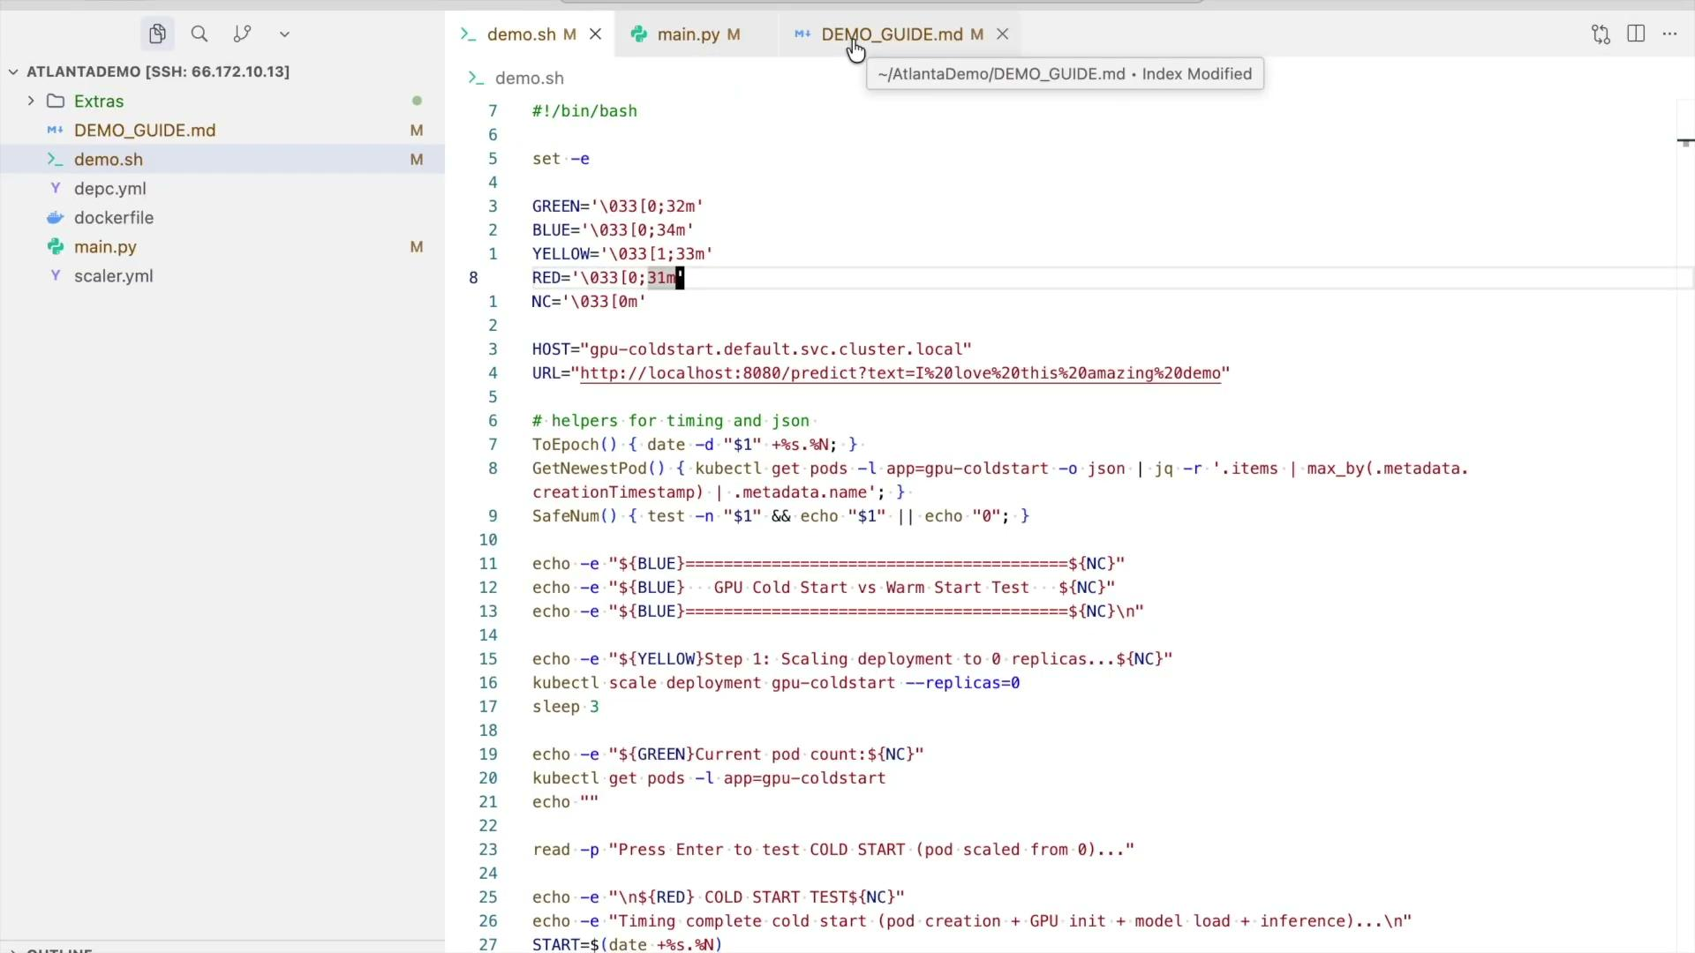
GPU serverless is fast… once it’s warm
Demo showing how cold start takes time compared to a warm one

Slide 4
CPU vs GPU Cold Starts
CPU Serverless
GPU Serverless
Container: 1-2s
Runtime: 0.5s
Code load: 0.5s
Container: 3-5s
CUDA setup: 2-4s
Model load: 8-15s
Total: 2-3s ✓
Total: 15-25s ✗
Notes:
On CPU-based serverless compute, starting a container, launching the runtime, and importing code typically completes within a couple of seconds. GPUs, however, require loading drivers, establishing CUDA runtime state, transferring model weights into GPU memory, and building execution contexts. These steps add up to much longer startup times. So while CPU serverless workloads feel instant, GPU serverless workloads often feel sluggish unless pre-warmed. This contrast sets the stage for why GPU cold starts are fundamentally a deeper system issue, not just an application detail.

Slide 5
What’s Different?
Aspect
CPU
GPU
Init time
Run time
Model load
Warm up
Resource Binding
Container: 1-3 s
Simple Runtime
RAM
Negligible
Native
Container: 10-60s
Nvidia drivers
Slow (VRAM transfer)
CUDA Context
Device plugin
Notes:
The root cause is that GPU execution depends on hardware-level context setup and model memory placement. CPU workloads can begin running with minimal memory preparation, but GPU workloads require binding VRAM, initializing kernels, and sometimes power-state transitions. These operations can’t be skipped or shortcut the first time. So GPU cold starts have structural latency that must be understood before being optimized. The key is breaking this down into the stages that shape the total delay.

Slide 6
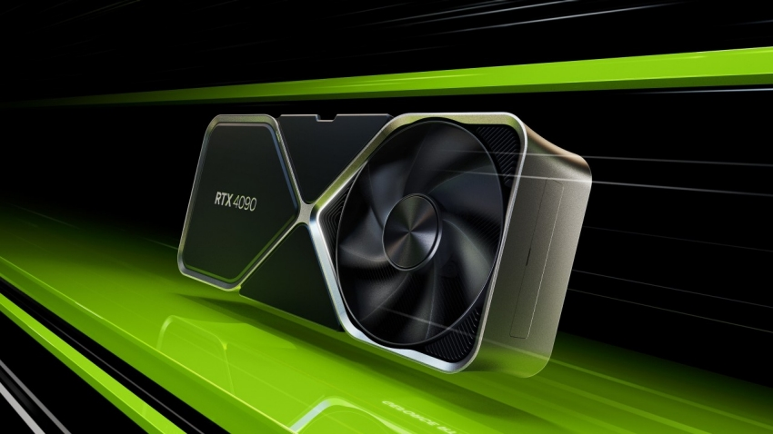

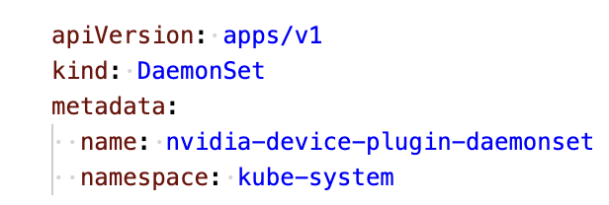
GPU in Kubernetes
GPU Hardware
Computation
Nvidia Driver
Communicate
Container Runtime Toolkit
Access
Device Plugin
Inform and Expose
Notes:
A GPU workload in Kubernetes involves several interacting layers beyond just the application.
NVIDIA device plugin first advertises GPU resources to the scheduler.
Then the NVIDIA container runtime injects driver libraries (libcuda.so, libnvidia-ml.so) into the pod.
Nvidia drivers actually talk to the gpu hardware and which in turn do the actual computation

Slide 7
What's Happening Under the Hood?
Pod & Runtime Init (K8s orchestration)
→ Scheduler + kubelet assign GPU, device plugin exposes resources.
Container + Driver Init (CRI + NVIDIA runtime)
→ Load NVIDIA drivers, CUDA runtime, establish device handles.
Device Context Warm-up
→ CUDA context creation, memory graph build, kernel caching.
Model Weight Load (Deserialization)
→ Transfer large weights (GBs) to VRAM, allocate GPU memory.
Notes:
There are four major phases: pod scheduling and resource binding, GPU driver/runtime setup, CUDA context creation, and finally, loading model weights into GPU memory. Each phase adds latency, and each one behaves differently depending on system state. Some parts only happen once per node boot; others happen once per container; others happen once per model; and some even happen once per request. Our job is to identify which steps are avoidable, which are reducible, and which can be deferred or parallelized.

Slide 8
The Orchestration Tax
Kubernetes Scheduler and Kubelet
When a GPU pod is submitted, the Kubernetes scheduler looks for a node advertising available GPU resources.
GPU resources are not native to Kubernetes; they’re exposed via
NVIDIA’s Device Plugin.
The scheduler waits until a node reports “nvidia.com/gpu: ” as allocatable.
Notes:
When a GPU-backed pod is requested, Kubernetes can’t just schedule it anywhere. GPUs aren’t native resources in Kubernetes, so the scheduler relies on NVIDIA’s device plugin to advertise which nodes actually have available GPUs. The scheduler has to wait until a node reports a free nvidia.com/gpu before it can even place the pod. And the kubelet on that node then has to coordinate attaching the GPU into the container runtime. All of that adds overhead before we even get to drivers, CUDA, or model loading. So part of the cold start cost is simply the cluster figuring out where this workload is allowed to run.

Slide 9
Latency Sources
Scheduling delay: Pod remains in “Pending” until the Device Plugin reports available GPUs (hundreds of ms to seconds).
Device allocation delay: The kubelet interacts with the plugin over gRPC to allocate a specific GPU ID.
rpc ListAndWatch(Empty)
rpc Allocate(AllocateRequest)
Cold node path: If the node just came online or restarted, this handshake adds 1–3 seconds.
Notes:
First, the pod can sit in a “Pending” state while the device plugin reports which GPUs are available. That can take anywhere from a few hundred milliseconds to a couple of seconds. Then, once a node is chosen, the kubelet has to request a specific GPU ID from the device plugin over gRPC before the container can start. And if the node has just been restarted or recently joined the cluster, that initial handshake between kubelet and the plugin adds another second or two. None of this involves loading the model yet — this is just the cluster negotiating who gets which GPU.

Slide 10
NVIDIA Device Plugin
Runs as a DaemonSet on each GPU node.
Discovers GPUs using NVML (NVIDIA Management Library).
Advertises GPU resources to the kubelet.
Handles allocation requests: decides which /dev/nvidia* device to mount into the container.
Notes:
In short, The device plugin scans for GPUs and assigns device files to containers.
The important point is that GPU resource exposure itself is not instant.

Slide 11
Latency Sources
Discovery latency: On node start, NVML takes ~1–2 seconds to enumerate devices.
Allocation latency: Each pod request triggers a device allocation call via gRPC; if contention or re-init occurs, it can take seconds.
Serialization overhead: In multi-GPU setups, device plugin sometimes serializes allocations to avoid conflicts.
Notes:
Even inside the device plugin itself, there are places where latency creeps in. When a node comes online, NVML needs a second or two just to enumerate all the GPUs. Then, for every pod that requests a GPU, the plugin and kubelet coordinate over gRPC to allocate a specific device. If the GPU was recently freed or the driver context needs to be reinitialized, that call can take a few extra seconds. And in multi-GPU nodes, the plugin sometimes serializes allocation decisions to avoid conflicts, which adds just a bit more delay. These steps are small individually, but together they stack up before the container even begins loading the model.

Slide 12
Container Runtime Interface (CRI)
Kubelet calls CRI (containerd / CRI-O / Docker-shim) to create the container.
The CRI uses the NVIDIA Container Runtime hook to inject GPU libraries, drivers, and environment variables.
It mounts:
  /dev/nvidia0, /dev/nvidiactl, /dev/nvidia-uvm, etc.
  Libraries like libcuda.so, libnvidia-ml.so into /usr/lib64 inside container
Notes:
Once Kubernetes selects a node, the CRI runtime (typically containerd) initializes the container environment.
When GPUs are requested, the NVIDIA runtime hook injects the necessary libraries and device mounts.
easiest areas to optimize through pre-pulling, caching, and persistent driver containers.

Slide 13
Latency Sources
Mount setup delay: Each mount and library copy (especially on slow disks or networked filesystems) adds milliseconds–seconds.
Hook execution time: NVIDIA runtime hook validates driver/runtime compatibility - an extra few seconds on first use.
Cold driver path: If driver container or runtime images were evicted, it has to re-pull and unpack them (~tens of seconds).
Notes:
There are a few more latency contributors once the runtime hook kicks in. First, mounting the GPU device files and copying or linking the CUDA libraries into the container can take from milliseconds to a couple of seconds, depending on disk and filesystem speed. Then the NVIDIA runtime hook does a compatibility check to make sure the container’s CUDA libraries and the host drivers match. That check is quick on warm nodes, but on first use it adds a few seconds. And if the driver or runtime cache was evicted, the node may need to re-pull and unpack those driver components, which can add tens of seconds. So again, these small steps stack up and show why GPU cold starts feel so slow.

Slide 14
Container started, what now?
The application can now:
Create CUDA contexts (200-300ms initialization)
Allocate GPU memory (in large pools)
Launch kernels (non-preemptible execution)
Process data parallely on a lot of cores and hope it gives correct output
Notes:
Once the container is finally running, the application still has a bit of work to do before it can actually run inference. creating a CUDA context, allocating GPU memory, often in pretty large blocks, depending on the model. And then launching kernels and doing the real compute work.

Slide 15
CUDA Runtime
What Happens (inside your container):
Once the container is running, CUDA APIs like cudaSetDevice() and cuInit() create a CUDA context by talking to the GPU driver.
Runtime loads device properties, allocates initial VRAM buffers, and JIT-compiles kernels.
Notes:
So lets see what all happens once the container has started and how each step adds up to the latency sources
First comes The CUDA Runtime,
CUDA runtime is the API layer (the functions you call in code, like cudaMalloc, cudaLaunchKernel, etc.). It’s essentially a convenience wrapper on top of the lower-level Driver APIs. So, When you make your first CUDA Runtime call that requires GPU access, the runtime will implicitly create a CUDA context by calling into the Driver APIs

Slide 16
CUDA Context Initialization
Allocating context-local memory in VRAM to track state (streams, kernels, handles).
Initializing the GPU command processor to accept instructions.
Loading PTX / SASS kernel stubs into GPU instruction memory (JIT if needed).
Setting up virtual memory mappings between the process and the GPU’s memory controller.
Establishing RPC channels between user-space (libcuda.so) and kernel-space (nvidia.ko).
Notes:
So as i just mentioned the runtime Calls trigger the creation of a CUDA context by talking to the GPU drivers.
So lets now understand what does the CUDA context initialization do why is it needed
Mainly this context creation step sets up the GPU for use:
it allocates some private memory in VRAM to track things like kernels and streams,
it initializes the GPU’s command processor
it loads PTX or SASS kernel stubs into instruction memory, sometimes JIT-compiling them the first time.
CUDA context also sets up virtual memory mappings and communication channels between the user-space CUDA runtime and the kernel driver.

Slide 17
Latency Sources
It requires driver kernel GPU negotiation.
If GPU was idle, power state must ramp from P8→P0 (low power to performance state).
GPU interrupts and scheduling queues are initialized lazily.
Typical Latency:
~150 ms to ~2000 ms (depends on GPU, driver, power state).
Notes:
Lets understand how cuda runtime and cuda context add up to latency sources
Even after the CUDA context is created, there can be some additional latency depending on the GPU’s current state. The driver and kernel still have to negotiate command channels with the hardware.
If the GPU was idle, it may be sitting in a low-power mode, typically P8, BUT it needs to ramp up to a full performance state like P0 before execution begins.
This power transition alone can add noticeable delay. So we often see anywhere from around 150 milliseconds up to a couple of seconds just from the GPU waking up and getting ready to run and work.

Slide 18
Model Weights → CPU RAM → GPU VRAM Transfer
Load from disk / container layer into CPU memory.
Deserialize into contiguous tensor buffers, Framework allocates GPU memory via CUDA malloc.
Copy from host (RAM) to device (VRAM) using:
  PCIe (12–28 GB/s effective)
  NVLink (50–150 GB/s effective, if available)
Notes:
Now comes one of the biggest contributors to GPU cold start time: loading the model weights.
First, the model has to be read from disk or the container image into CPU memory. Then the framework deserializes those weights into actual tensor buffers.
Once that’s done, GPU memory is allocated and the weights have to be copied from CPU RAM into GPU VRAM. That copy happens over PCIe or NVLink, and for large models this alone can take several seconds. So this is where you really feel the cost of large transformers or diffusion models — the data movement itself becomes a significant part of the cold start path.

Slide 19
Latency Sources
Large models = gigabytes to move.
If weights are fp32 → often converted to fp16/bf16 at load time → extra compute overhead.
NUMA penalties if CPU RAM is on wrong memory bank.
Typical Latency:
7B model: ~0.7–3 seconds; 13B+: 2–10 seconds.
Notes:
And the challenge grows with model size. A 7B parameter model might mean moving one to three gigabytes of weights into GPU memory. Larger models like 13B or 70B scale that cost up very quickly. If the weights are stored in fp32, many frameworks will convert them to fp16 or bf16 during load, which adds extra compute time up front. And depending on system architecture, if the CPU memory holding the weights is on the wrong NUMA node relative to the GPU, you pay an additional bandwidth penalty just moving the data. So even after all the orchestration overhead, we still have this final and very real cost: moving gigabytes of model state over the bus before inference can begin.

Slide 20
Workspace and Memory Pool Allocation
Deep learning libraries use internal scratch buffers to reduce repeated malloc/free overhead:
cuBLAS: GEMM tiling workspace.
cuDNN: convolution algorithm scratch.
Attention kernels: QKV projections, softmax workspace.
Framework-level GPU memory caching (PyTorch’s CUDACachingAllocator)
Notes:
Now , lets learn about Workspace and Memory Pool Allocation
So ,
Once the model weights are in VRAM, most deep learning libraries also need to allocate extra GPU memory for temporary workspace. Libraries like cuBLAS and cuDNN use scratch buffers to optimize GEMM and convolution operations.
Attention layers also need their own workspace for QKV projections and softmax. And frameworks like PyTorch manage a memory pool with the CUDA caching allocator to avoid repeated malloc/free calls.
Allocating these buffers is usually fast, but it still adds a bit of latency on the first request. After that, the memory is reused and performance becomes steady.

Slide 21
Latency Sources
GPU memory fragmentation means allocator may need to defragment (involves memcpy or partial realloc).
First few batches may trigger dynamic resizing until steady-state memory footprint stabilizes.
Notes:
Coming to the latency contributions, Once the workspace buffers are allocated, the GPU allocator may still need to do some cleanup during the first few requests. If the GPU memory is fragmented or previously used by something else, the allocator may need to compact or reallocate blocks, which can involve extra memcpy operations.
also during the first few inference runs, the framework may dynamically resize memory pools as it figures out the steady-state footprint for the model. So those first one or two batches can be slower, and then performance levels out once the memory layout stabilizes

Slide 22
Runtime Data Transfer and Batching
Inputs (token IDs, image tensors, etc.) often begin in CPU memory.
They are copied into GPU staging buffers each inference.
If dynamic batching is enabled (Triton, vLLM, FasterTransformer):
  Requests queue until batch is formed.
  GPU compute is amortized over multiple inputs.
Notes:
The last major piece that adds up to our troubles is the Runtime Data Transfer and Batching
At inference time, most inputs start in CPU memory, whether that’s token IDs for language models or image tensors for vision models. So each request involves copying that input data into GPU staging buffers before execution can start. If we’re using dynamic batching with something like Triton, vLLM, or FasterTransformer, requests may wait briefly while the system forms a batch.
The upside is that batching amortizes compute across multiple inputs and improves throughput, but it does add a small queueing delay. So even after the model is fully loaded, we still have this constant CPU-to-GPU data movement in the hot path.

Slide 23
Latency Sources
Small inputs lead to low compute-to-transfer ratio → poor efficiency.
Batch formation may introduce queue delays under low throughput traffic.
Notes:
A big thing to notice here is that when inputs are small, the time spent just moving the data to the GPU can actually be larger than the time spent computing on it. That leads to pretty poor efficiency. And if we’re using dynamic batching, batching helps throughput, but under low traffic it means requests may wait a little while for a batch to form. So depending on workload patterns, input transfer and batching can add a bit of unpredictable latency on top of the compute itself

Slide 24
Strategies to Eliminate Cold Starts

Slide 25
Solution Overview
1. Avoid the cold start
Pre-warmed GPU pools keep models ready
2. Speed up the cold start
Model snapshotting with TorchScript, ONNX, Safetensors
3. Defer the cold start
Lazy loading delays initialization until first request
Notes:
So now that we’ve seen where all the latency comes from, the solutions fall into three broad strategies. First, we can avoid cold starts entirely by keeping a pool of GPU pods already warm, ready to serve traffic immediately. Second, if we do need to spin up new pods, we can speed up the startup itself by using model snapshotting techniques like TorchScript, ONNX, or Safetensors to reduce load and deserialization overhead. And third, we can defer parts of initialization by using lazy loading so that only the work needed for the first request is done upfront, with the rest happening gradually as traffic arrives. We'll go through each of these in detail.

Slide 26
Solution 1: Pre-warmed GPU Pools
Load Balancer
Request Queue
GPU 1 (warm)
GPU 2 (warm)
Model loaded
Model loaded
Notes:
The simplest approach is to avoid cold starts entirely by maintaining a small pool of warm GPU instances. Each instance already has the model loaded, CUDA initialized, and memory pools set up. The load balancer sits in front, and requests are immediately routed to whichever GPU is free. This works well when request volume is steady or predictable. The tradeoff is cost: you’re paying for GPU time even when traffic is low. But for real-time systems, it’s often worth it because you get consistent latency with no startup penalty.

Slide 27
Pool Management Strategies
Static Pool
Fixed number of warm instances. Simple but inflexible.
Dynamic Pool with Min Replicas
Autoscaling with guaranteed minimum. Balances cost and performance.
Predictive Scaling
ML-based traffic forecasting. Scales proactively before demand spikes.
Notes:
There are a few ways to manage these warm GPU pools. The simplest is a static pool, where you keep a fixed number of instances ready at all times. It’s reliable, but you might overpay during quiet periods. A more balanced approach is a dynamic pool with a minimum replica count: you always keep some GPUs warm, and autoscaling adds more only when traffic rises. And for teams with predictable patterns, predictive scaling works really well. By forecasting demand with basic ML or even simple time-based rules, you can scale GPUs up before the traffic spike hits, avoiding cold starts entirely.

Slide 28
Pre-warmed Pools: Benefits & Tradeoffs
Benefits
Tradeoffs
Zero cold start latency
Predictable performance
Better GPU utilization
Instant scale-out capability
Higher idle costs
Pool sizing complexity
Resource waste during low traffic
Autoscaling lag time
Notes:
Pre-warmed pools keep a small set of GPU instances already initialized with the model loaded. That removes cold start latency completely and gives predictable, stable performance. It also lets us scale out immediately when traffic increases.
The tradeoff is cost. If traffic is low, we’re paying for GPUs that mostly sit idle. The pool size needs to be tuned carefully: too small and we still hit cold starts, too large and we waste resources. Autoscaling can still lag if traffic is highly bursty.

Slide 29
Platform/Kubernetes
Keep 1 replica warm (if cost permits): Set replicas.min: 1 in scaler.yml to eliminate cold starts entirely. Alternatively, increase the scaledown/cooldown period so the pod stays warm longer between bursts.
Pre-pull the image on GPU nodes: Use a small DaemonSet to docker pull gpu-demo:latest on all GPU nodes so scale-up never waits on image pulls.
Pin to a warm GPU node: Use nodeSelector/affinity to stick to nodes that already ran your pod recently.
GPU persistence mode: Enable nvidia-smi --persistence-mode=1 via a DaemonSet to reduce driver initialization latency on first context creation.
Notes:
There are some simple Kubernetes-level tactics to reduce cold start overhead.
First, keep at least one replica warm if the budget allows, or extend cooldown so the pod stays alive longer.
Next, pre-pull the container image on all GPU nodes so scale-up never waits on image pulls.
Then, try to schedule onto nodes that recently ran the model, since GPU context and allocations are likely still warm.
Finally, enable GPU persistence mode to avoid the driver reinitialization cost when the first CUDA context is created.

Slide 30
Image-level Optimization: Ensure Model Cache Path is Stable
TRANSFORMERS_CACHE=/models/hf
HF_HOME=/models/hf
TOKENIZERS_PARALLELISM=false
HF_HUB_DISABLE_TELEMETRY=1
Notes:
Here we make sure the model cache path inside the container is fixed and baked into the image. That way, the model and tokenizer are already present at startup instead of being re-downloaded into a new ephemeral cache directory on every pod. We also disable tokenizer parallelism to avoid the thread pool initialization spike on the first request. Overall, this makes initialization deterministic and removes a hidden source of cold start slowdown.

Slide 31
Image-level Optimization: Reduce Import Overhead
Move heavy imports out of request handler and into startup or module scope.
Prefer:
from transformers import ...
import torch
at top of file, not inside functions.
Notes:
We also reduce cold start time by avoiding heavy imports inside the request path. Libraries like Transformers and PyTorch have noticeable module load and class initialization costs. So instead of importing inside the handler, we move those imports to module scope or startup time. That way, the import work happens once when the container starts, not on the first request. This removes a small but consistent latency spike.

Slide 32
Image-level Optimization: Bundle Model into the Image
During cold start, the container tries to download or fetch the model weights (HF Hub, S3, or remote cache). This adds network I/O + decompression delay.
Mitigation:
Pre-download model + tokenizer inside the Docker image layer during build.
Notes:
If the model isn’t baked into the container, the pod may download it during startup, which adds network time and decompression delays. Instead, we bundle the model and tokenizer directly into the Docker image at build time. That way, cold starts load weights straight from local disk. It removes variability, eliminates external fetch latency, and works well even when scaling to zero, because the image layers remain cached on the node.

Slide 33
App Runtime Optimization: Single Warm-up Forward Pass
After loading the model onto GPU:
with torch.inference_mode(), torch.autocast("cuda", dtype=torch.float16):
model(**tokenizer("warmup", return_tensors="pt").to("cuda"))
torch.cuda.synchronize()
Notes:
Okay , so lets now discuss how we plan to optimize the App runtime .
So , Once the model is loaded onto the GPU, we run a single dummy forward pass. This warms up the CUDA context, triggers kernel autotuning, allocates cuDNN workspaces, and picks optimized tensor core execution paths. Without this, the first real request pays all of that setup cost.
By doing a quick warm-up pass at startup, we make the first user request just as fast as all the others.

Slide 34
Model Handling Optimization: Use FP16 (If GPU Supports Tensor Cores)
Right after load:
model = model.half().to("cuda")
Inputs:
with torch.autocast("cuda", dtype=torch.float16):
outputs = model(...)
Notes:
If the GPU supports tensor cores, we convert the model to FP16 right after loading. This cuts the weight footprint in half and reduces memory movement. Then at inference time, we wrap the forward pass in autocast so inputs are handled in FP16 as well. This usually gives a meaningful speedup and lowers GPU memory pressure without needing quantization or retraining.
Benefits:
Weight copy to VRAM is smaller
Memory pressure reduced → fewer workspace reallocations
Tensor core kernels used automatically

Slide 35
Model Handling Optimization: Avoid First-Request Tokenizer Cost
Warm tokenizer separately:
_ = tokenizer("warmup", return_tensors="pt")
Why:
Tokenizers (especially HF fast tokenizers in Rust) initialize internal FSA/trie structures on first call.
Notes:
Tokenizers have their own first-use cost. The Hugging Face fast tokenizers, which are Rust-based, build internal automata and lookup structures the first time they run. So we trigger a dummy tokenize call at startup. This makes sure that when the first real request arrives, tokenization is already warm and latency is flat from the start.

Slide 36
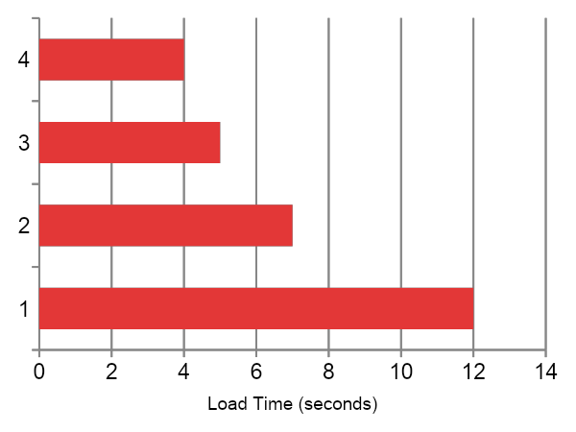
Solution 2: Faster Serialization
Different formats have drastically different load times
PyTorch pickle: 12s (slow)
TorchScript: 7s (better)
Safetensors: 5s (good)
ONNX: 4s (fastest)
Notes:
Cold start time is heavily affected by how the model is serialized. A standard PyTorch .pt or pickle load is convenient, but it’s slow because it reconstructs Python objects, which is expensive. TorchScript improves this by freezing more of the graph, so less Python work happens on load. Safetensors goes further by using a zero-copy, memory-mapped format that avoids deserialization overhead entirely and is safer by design. And for some architectures, exporting to ONNX gives the fastest load times because it’s already in a portable, framework-agnostic graph form that runtime engines can initialize quickly.
So the choice of serialization format alone can reduce your startup latency from double-digit seconds down to just a few seconds. This is one of the highest-impact levers when trying to speed up cold starts.

Slide 37
Model Snapshotting / Serialization
  TorchScript (torch.jit.trace / torch.jit.script)
  safetensors single-file converted and memory-mapped
  PyTorch state dict snapshot already converted to fp16
Effect:
Reduces startup CPU work, avoids re-running layer initialization code.
Notes:
Goal: Reduce time spent re-deserializing model weights and reconstructing Python-layer modules.
What Happens Normally:
Transformers load weights from multiple .bin / .safetensors shards.
Python constructors rebuild attention blocks, linear layers, state dict mappings.
This costs CPU time + Python object graph setup.
Mitigation:
Serialize a ready-to-run version of the model after construction, shape inflation, and dtype conversion.

Slide 38
Model Snapshotting / Serialization
model = AutoModelForSequenceClassification.from_pretrained(name).half().eval()
model = model.to("cuda")
torch.jit.save(torch.jit.trace(model, example_inputs), "model.pt")
Notes:
Benefits:
No PyTorch module graph rebuild on startup
No repeated dtype conversion
Smaller VRAM transfer footprint when fp16 snapshot is used
Often helps cold start drop ~0.5–2 sec depending on model size
Caution:
If model uses dynamic control flow, prefer script() over trace().

Slide 39
Solution 3: Lazy Loading
The Pattern
Container starts instantly
Model remains unloaded
First request triggers load
Subsequent requests are fast
When to Use
Fast container startup needed, can tolerate first-request penalty
Notes:
Lazy loading flips the strategy. Instead of paying the cost up front, we let the container start instantly with the model still unloaded. The first request is what triggers the model load into GPU memory. After that, performance is just as fast as normal, because the model stays resident.
This works well when we prioritize very fast scale-to-zero recovery, or when we’re deploying many different models where only a subset get active traffic. The tradeoff is that the first request after startup will be noticeably slower. So this pattern makes sense in workloads where occasional first-request latency is acceptable, like dashboards, internal tools, or workloads with predictable warm-up periods. It’s less ideal for strict real-time API latency guarantees.

Slide 40
Lazy Loading
What Lazy Loading Means:
Only load critical path parts during startup.
Everything else is loaded on first actual use or in background.
Where It Helps:
Tokenizer initialization
Model head layers (e.g., classification heads)
Optional modules (e.g., generation utilities)
Notes:
Lazy loading doesn’t mean “load nothing.” It means we only load the pieces needed for the critical request path at startup. Everything else is deferred until the moment it’s actually needed, or loaded in the background while the service is already running.
This is especially helpful for things like tokenizer initialization, which has a noticeable first-use cost. It also applies to optional or heavier model components, like classification heads or generation utilities that may not be required for every request. By splitting the load into essential vs. optional, we cut startup time without permanently paying the first-request penalty for every part of the stack.

Slide 41
Enable lazy components in startup
# Load tokenizer metadata only
tokenizer = AutoTokenizer.from_pretrained(name, lazy_init=True)
# Defer GPU mapping of some buffers until first inference
model = AutoModelForSequenceClassification.from_pretrained(name)
model.to("cuda", non_blocking=True)
Notes:
Here we’re explicitly using lazy initialization features. The tokenizer is loaded in a metadata-only mode first, so it skips building the internal tokenization tables until it’s actually used. For the model, we load it into memory but defer fully mapping all buffers to the GPU until the first inference. Using non_blocking=True helps overlap that transfer with other work. The effect is that container startup becomes much faster, because we avoid doing all heavy memory and table initialization up front. Instead, the work is spread across the first few moments of runtime or the first request, smoothing out the cold-start spike.

Slide 42
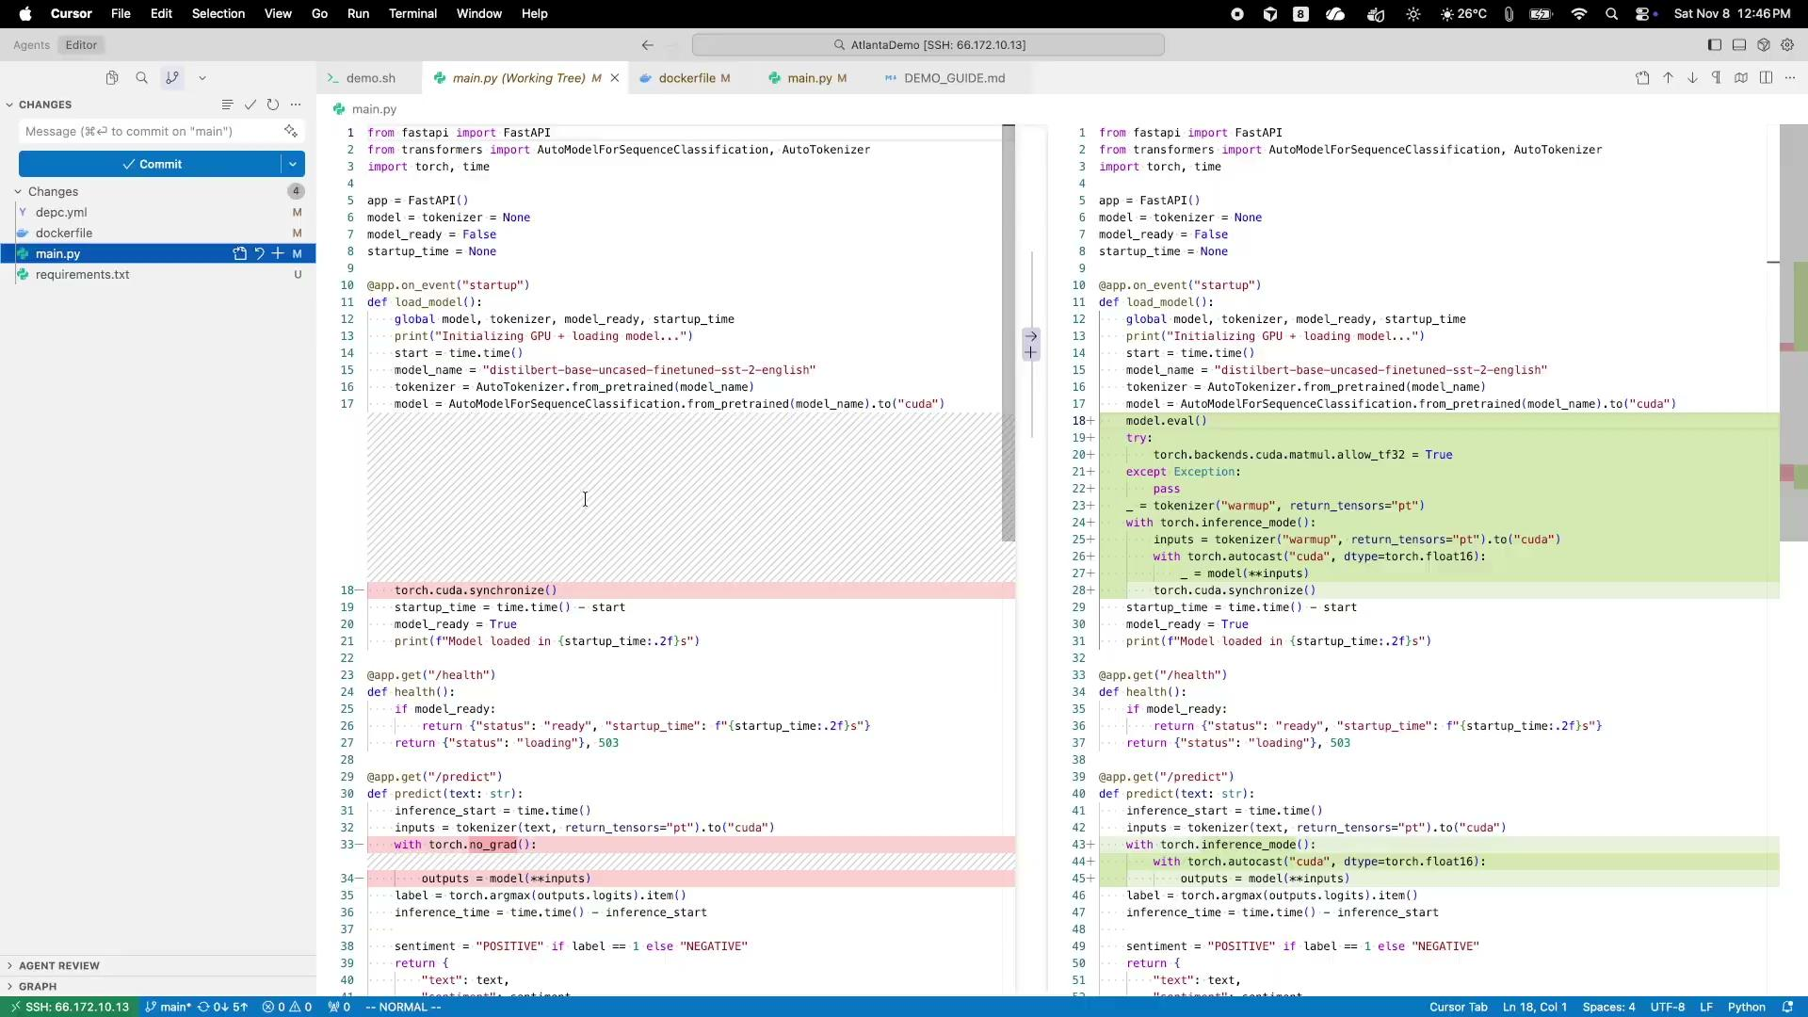
Using a few tips and tricks
Demo 2
Notes:
dockerfile: pre-caches model/tokenizer, sets cache envs, and uses no-cache installs.
main.py: adds GPU warm-up and faster inference contexts; keeps the same model.
depc.yml: ensures runtime uses the baked HF cache

Slide 43
Combining Strategies
Production Architecture
Pre-warmed pool: min 2 replicas, max 10
Models serialized in ONNX format
Lazy loading for rarely-used models
Aggressive autoscaling on traffic spikes
Notes:
In practice, we almost never rely on just one technique. A good production setup layers them. We keep a small pool of pre-warmed GPU instances so most requests see zero cold start. We store models in a faster serialization format like ONNX so loading is quicker and consistent across environments. For models that are rarely hit, we avoid paying that cost upfront by using lazy loading, so they only initialize when traffic actually arrives. And finally, we configure autoscaling to react quickly to spikes, so the warm pool can expand before user latency degrades. The result is predictable performance under normal load, while still staying cost-efficient and resilient when traffic patterns shift.

Slide 44
Emerging Techniques
GPU State Snapshotting
NVIDIA CRIU integration: checkpoint running GPU process, restore in seconds
Memory-mapped Models
Keep weights in shared memory, fork process with model pre-loaded
Speculative Warm-up
Predictive scaling based on traffic patterns, start warming before traffic arrives
Notes:
These are techniques that are emerging but not yet widely deployed. GPU state snapshotting uses NVIDIA’s CRIU integration to checkpoint a running GPU process. Instead of reloading the model and rebuilding all GPU state, we restore from a snapshot in seconds. Memory-mapped models go a different direction: weights are kept in shared memory, and new processes simply fork with the model already present, avoiding redundant loads. And speculative warm-up looks at traffic patterns and begins warming models before requests actually arrive. Each of these reduces cold start latency even further, and we’ll likely see them mature into the mainstream over the next couple of years.

Slide 45
Choosing the Right Approach
Need lowest possible latency?
Need cost optimization?
→ Pre-warmed pool with min replicas
→ Lazy loading + scale-to-zero
Need simple deployment?
Need maximum control?
→ Managed platforms
→ DIY with K8s + device plugin
Notes:
There’s no single best pattern. It depends on what we’re optimizing for. If we need the absolute lowest latency, we use a pre-warmed pool with a minimum number of replicas always running. If cost is the priority, we lean on lazy loading and scale-to-zero so we only pay when traffic is present. If the goal is simply to get something running quickly without dealing with GPU scheduling or runtime tuning, managed platforms like Modal or RunPod can handle most of the heavy lifting. And if we need full control over scheduling, placement, and GPU behavior, then running on Kubernetes with the NVIDIA device plugin gives us that flexibility. The key is to pick the strategy that aligns with performance, cost, and operational complexity tradeoffs for your workload.

Slide 46
Key Takeaways
1. GPU cold starts are 5-10x slower than CPU (15-25s vs 2-3s)
2. Main culprits: driver init, CUDA context, model deserialization
3. Pre-warming is the gold standard for production systems
4. Serialization format matters: ONNX > TorchScript > pickle
5. Managed platforms handle complexity for you (at a cost)
Notes:
The main takeaway is that GPU cold starts are fundamentally slower than CPU cold starts, often 5–10x. Most of that delay doesn’t come from your code, but from system-level overhead like driver initialization, CUDA context setup, and model deserialization. In production, the most reliable solution is to avoid cold starts entirely by keeping a small pre-warmed pool running. When you do need to start from cold, the serialization format has a big impact, with ONNX and Safetensors consistently loading faster than raw PyTorch checkpoints. And finally, if managing all of this at the system level is too heavy, managed serving platforms can abstract the complexity, though you trade that for higher runtime cost.

Slide 47

Feedback
https://github.com/Nk272/CNCFAtlanta

Slide 48
Thank You!
Questions?

